Slide 1
Bellman Ford Algorithm
Keyvan Dadashzadeh
Yasaman Lotfollahi

Slide 2
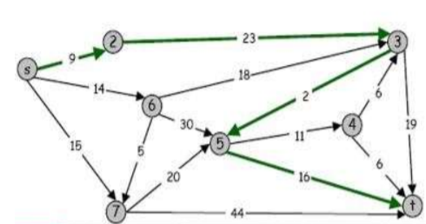

Shortest path problem
Shortest path network
Directed graph
Source s, Destination t
cost( v-u) cost of using edge from v to u
Shortest path problem
Find shortest directed path from s to t
Cost of path = sum of arc cost in path

Slide 3
Applications
Networks (Routing)
Robot Navigation
Urban Traffic Planning
Telemarketer operator scheduling
Routing of Communication messages
Optimal truck routing through given traffic congestion pattern
OSPF routing protocol for IP

Slide 4
Single source shortest path
Given graph (directed or undirected) G = (V,E) with
weight function w: E -> R and a vertex s € V,
find for all vertices v € V the minimum possible weight for
path from s to v.
There are two algorithms
Dijikstra’s Algorithm
Bellman Ford algorithm

Slide 5
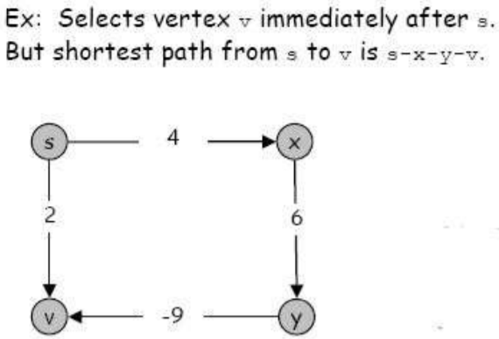
Bellman Ford
Dijikstra Algorithm fails when there is negative edge
Solution is Bellman Ford Algorithm
which can work on negative edges

Slide 6
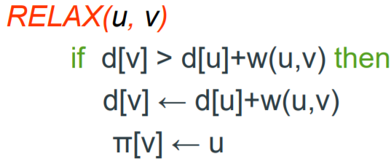
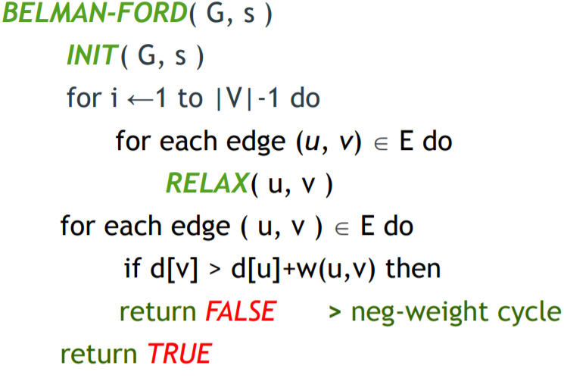

Slide 7
a
5
6
 | s | a | b | t
0 | 0 | INF | INF | INF
1 | 0
2 | 0
3 | 0
s
-2
t
4
-9
b

Slide 8
5
a
5
6
 | s | a | b | t
0 | 0 | INF | INF | INF
1 | 0 | 5 | 4 | INF
2 | 0
3 | 0
s
-2
t
INF
4
-9
b
4

Slide 9
5
a
5
6
 | s | a | b | t
0 | 0 | INF | INF | INF
1 | 0 | 5 | 4 | INF
2 | 0 | 5 | 3 | 11
3 | 0
s
-2
t
11
4
-9
b
4

Slide 10
5
a
5
6
 | s | a | b | t
0 | 0 | INF | INF | INF
1 | 0 | 5 | 4 | INF
2 | 0 | 5 | 3 | 11
3 | 0 | 5 | 2 | 11
s
-2
t
11
4
-9
b
2

